Slide 1
PASSWORD CRACKING
USING USB RUBBER DUCKY

Slide 2
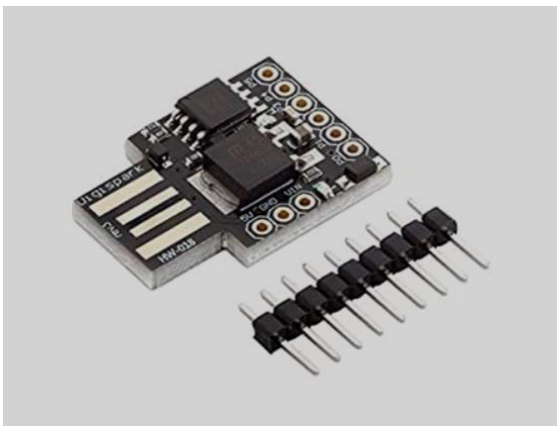
Introduction:
USB Rubber ducky is like a hacking tool that looks like a pen drive. This is useful to steal victims’ essential and credential data by injecting payload into the USB Rubber ducky and connecting it to the victim's computers. We will plug the USB rubber ducky into the victim’s device and the script will automatically run through HID (Human Interface Device) means the computer thinks that the signals are coming from the keyboard and mouse and neither device’s firewall nor the anti-virus software can detect it.

Slide 3
USB rubber ducky acts as a keyboard and has keystrokes installed in it • When we connect it to the PC the keystrokes run automatically. • It has a high speed of approx. 1000 words per minute. So those works which can be done by keyboard can also be done by USB rubber ducky • Whenever it is connected to a System it acts as a keyboard and executes the command which is uploaded on it. • The commands used in this are known as payloads and they are written in Ducky script.

Slide 4
For this, we have implemented the brute force approach.
Algorithm: Brute force: Brute force is a simple attack method and has a high success rate. Some attackers use applications and scripts as brute-force tools. These tools try out numerous password combinations to bypass authentication processes.

Slide 5
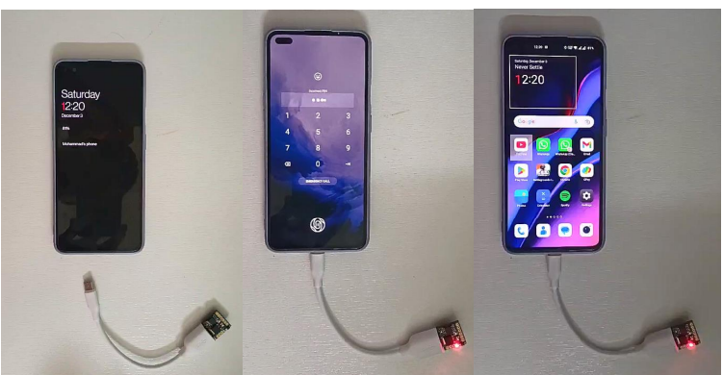

Slide 6
Wi-Fi Password:
In this the device is connected with rubber ducky as soon as the rubber ducky is start working within 21 to 30 seconds the saved Wi-Fi passwords that the computer saved are Shown to the attacker where the working of USB RUBBER DUCKY. the command prompt is opened first and then the commands are running as the following first in the command prompt it searched for passwords in the C drive which are saved in the properties of Ethernet and then it copies the ID and password of every saved WIFI passwords and then it will share the information to the link which is in the code of rubber ducky The link contains address of a database where the attacker has a unique ID for himself to get the information Note: to get the information from the device that is being attacked must have to connect with Internet. The device cannot detect any harmful attacks that are attacking because it is an HID so until we interrupt the rubber ducky the process goes on without interruptions.

Slide 7
D) What are the other possible ways (if any) to solve it: The Another possible way to get password is by using some software’s like WPS WPA tester which are costly and the software requires rooted devices to work, where the device may get bricked and may not work properly, to avoid that issues and complete our task we have chosen this approach.

Slide 8
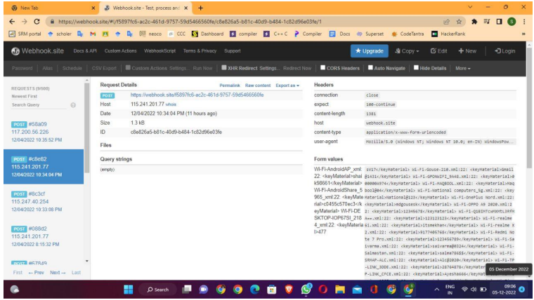

Slide 9
THE END
THANKYOU

